Slide 1
Improving long-term preservation EOS data by independently mapping HDF4 data objects
Mike Folk, Ruth Aydt, Peter Cao, Kent Yang
Ruth Duerr
Christopher Lynnes

Slide 2
Phase 2: Productizing HDF4 Mapping schema and tools for deployment

Slide 3
Phase 2 tasks
Investigate integration of mapping schema with existing standards
Determine HDF-EOS 2 requirements
Redesign the XML schema
Implement production quality HDF4 map writer
Develop demo HDF4 map reader and optional general reader
Develop test suite and validation utility for layouts and datatypes
Deploy tools at other NASA data centers.

Slide 4
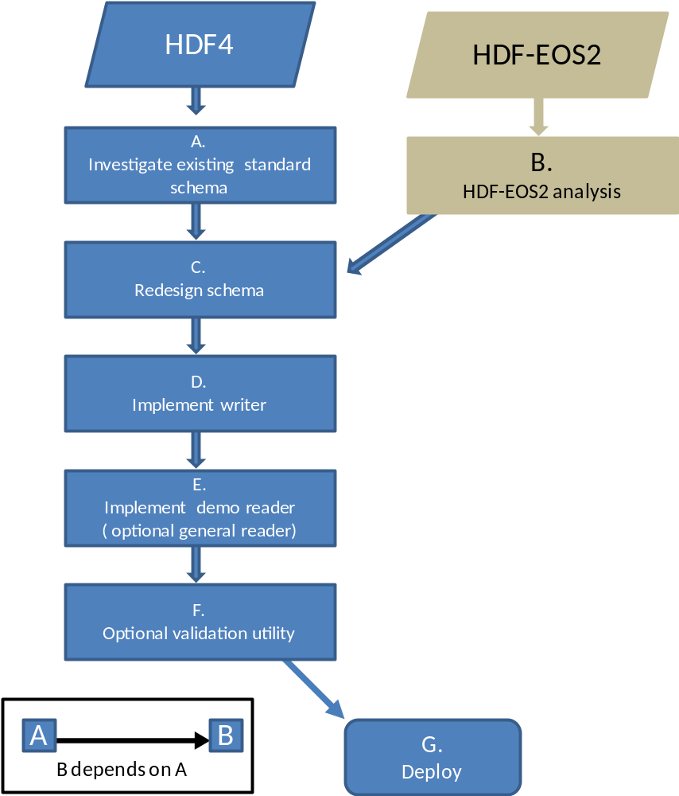
HDF4/HDF-EOS2 mapping workflow

Slide 5
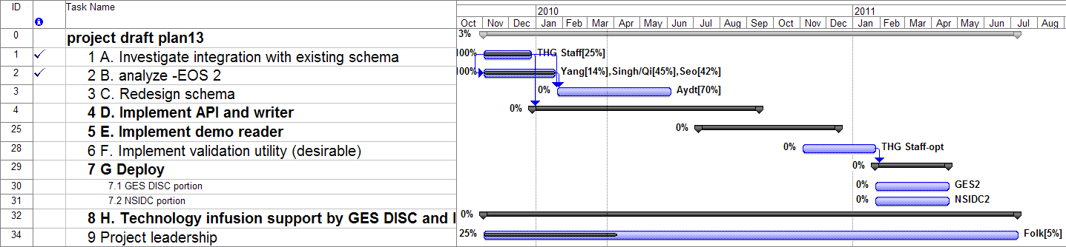

Slide 6
Task A
Investigate integration of mapping schema with existing standards

Slide 7
Task A
Status: complete except for report
Results
  Standards investigated included METS, PREMIS, ESML and NcML
  None really meet our needs.
  PREMIS is about the file but doesn’t address the contents.
  MIX approach harmonizes with it.
  Will try MIX approach, but it doesn’t
  For contents, it will deviate from PREMIS
  Elements will align with corresponding subset of PREMIS
  We have content that is a stretch for PREMIS
  Conclusion: We will not adopt any particular standard, but will try to harmonize with them and leverage familiarity with other things, such as the use of the Common Data Model (CDM).

Slide 8
Task B: Determine HDF-EOS2 requirements

Slide 9
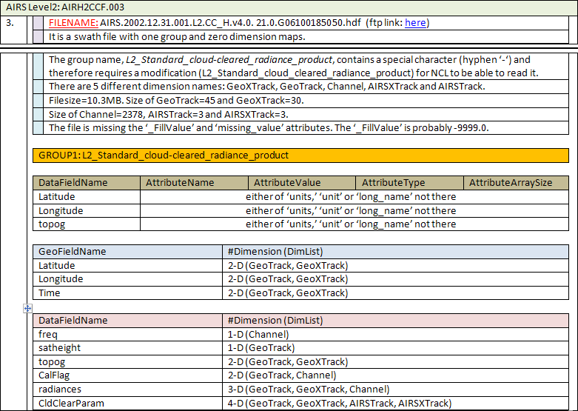
Categorize HDF-EOS2 data products
Status: Complete
Results:
  Create a data pool
    Data from GES DISC, NSIDC, LAADS, LP-DAAC and LaRC
  Detailed description of sample data
  Investigate HDF-EOS2 Swath, Grid and Point
  Summarize the requirements
  (next slide)

Slide 10
Requirements for HDF-EOS2 objects
Results (continued)
  Report to listing all options for adding HDF-EOS2 contents to the mapping file
  Documents and reports under the wiki page:
  http://wiki.hdfgroup.org/MappingPhase2_TaskB

Slide 11
Task C
Redesign Schema

Slide 12
Task C: Redesign Schema
Duration: Begin in January; Finish in June
Assigned to Ruth
Activities:
  1) Gather background information and knowledge:
  2) Formulate overall schema design and identify corner cases
  3) Detailed Schema design
  4) Documentation

Slide 13
Task D
Implement Writer

Slide 14
Task D: Implement Writer
Duration: Began in March; Finish in Sept
Assigned to: Binh-Minh Ribler and Joe Lee
Activities:
  Implement API to for creating maps (Binh-Minh)
    Develop new writer requirements, based on new XML schema and additional deployment needs
    Design APIs
    Implement new features
    Document
  Implement writer (Joe)
    Design writer tool
    Implement writer
    Implement test suite for writer
    Document

Slide 15
Status of Task D
Implement API to for creating maps
    Requirements and design nearly complete
    Some implementation has been completed
    A bit behind schedule, but no threat to schedule
Implement writer (Joe)
    Design process is underway
    On schedule for completion by September

Slide 16
Task E: Implement demo reader
Duration: Begin in June, complete in Sept
Assigned to: Ruth Duerr
Activities:
  Develop requirements, based on new schema and identification of additional deployment needs.
  Design reader, based on requirements, and from a review of the prototype design.
  Implement reader.
  Document reader.
  Test reader on EOS file “zoo”
  Deposit reader, documentation, and tests in open source repository, probably SourceForge.

Slide 17
Task F: Implement validation utility
Optional task
No plans currently to perform

Slide 18
Task G: Deploy
Duration: Begin in Jan 2010, complete in April
Assigned to: NSDC and GES DISC
Activities:
  GES DISC
    Incorporate into the existing archive ingest system
    Manage the retrofit into existing metadata files
  NSIDC
    Implementation effort for the V0 data
    Support implementation in NSIDC’s ECS system
  Other ESDCs will be encouraged to join in the effort, but it is assumed that deployment to other centers will occur for the most part subsequently to the project.

